Slide 2

Unit 11: Implementing Navigation in your Application

Slide 3
Lesson Objectives
After completing this lesson, you should be able to:
Describe the use of shared components in an application
Create, edit, and use the following shared components that aid navigation in an application:
Lists
Navigation Menus
Breadcrumbs
Navigation bar entries
Notes:
In this lesson, you learn how to implement navigation in your application.

Slide 4
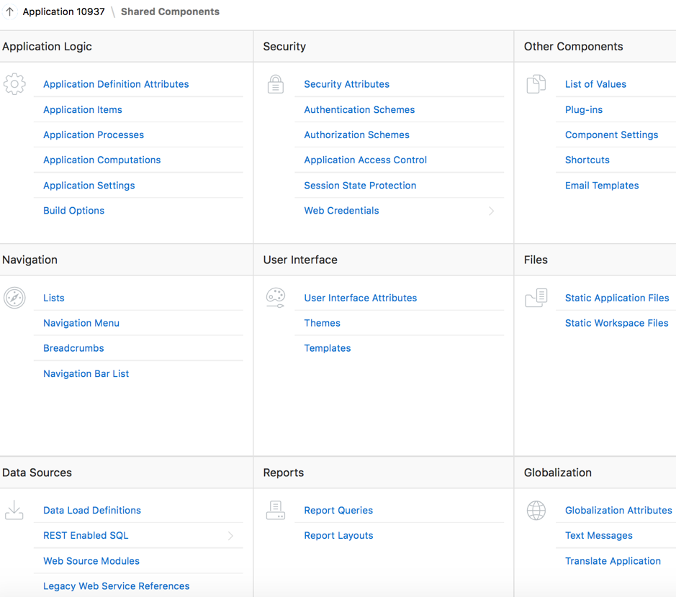
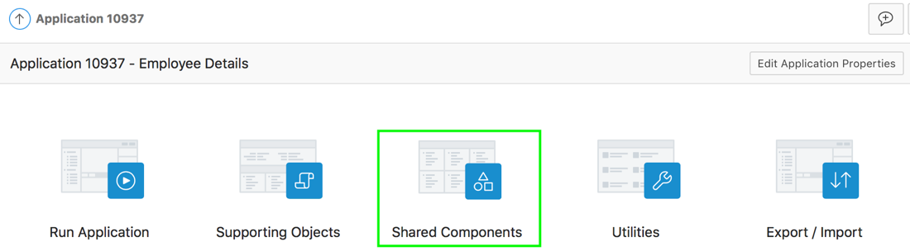
Understanding Shared Components
Page Designer
Application Home Page
Notes:
Breadcrumbs, Lists, and navigation bar entries are examples of shared components. Shared components are common elements that can display or be applied on any page within an application. You can use the tools and wizards on the Shared Components page either at the application-level or on specific pages. The big advantage of shared components is that once you create them, you can add them to any page within your database application.
To access the Shared Components page:
On the Workspace home page, click App Builder. Select an application.
On the Application home page, click Shared Components. The Shared Components page appears.
Once you select an application, you can even access the Shared Components page by clicking the Shared Components icon at the top of the page. The Shared Components icon consists of a triangle above a circle and a square. This icon displays at the top of most App Builder pages including the Application home page, Page Designer, Supporting Objects, and Utilities.
This lesson covers the navigational shared components such as lists, navigation menu, and bread crumbs.

Slide 5
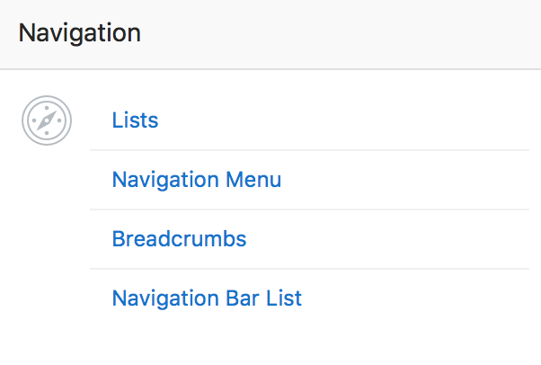
Understanding Navigational Shared Components
Notes:
When you build a database application, you can include different types of navigation controls. The available navigation option depend upon the application theme. Common navigation controls include tabs, lists (including navigation menus), breadcrumbs, navigation bar entries, and branches.
Lists: A list is a shared collection of links. You control the appearance of a list through list templates. Each list element has a display condition that enables you to control when it displays.
Navigation Menu: A navigation menu is a list links that enables users to navigate the pages in an application. Navigation menus are only supported in applications using the Universal Theme - 42.
Breadcrumbs: Breadcrumbs provide users with hierarchical navigation. A breadcrumb is a hierarchical list of links that display using templates. You can display a breadcrumb as a list of links or as a breadcrumb path.
Navigation Bar List: Navigation bar entries offer users a simple navigation path for moving between pages in an application. The location of a navigation bar depends upon the associated page template. Navigation bar entries can display as a link from an image or text. A navigation bar entry can be an image, an image with text beneath it, or text.
Note: Tabs are an effective way to navigate users between pages in an application. Tabs only appear if the associated application uses an older theme. In new themes, Tabs have been replaced with Navigation Menu.

Slide 6
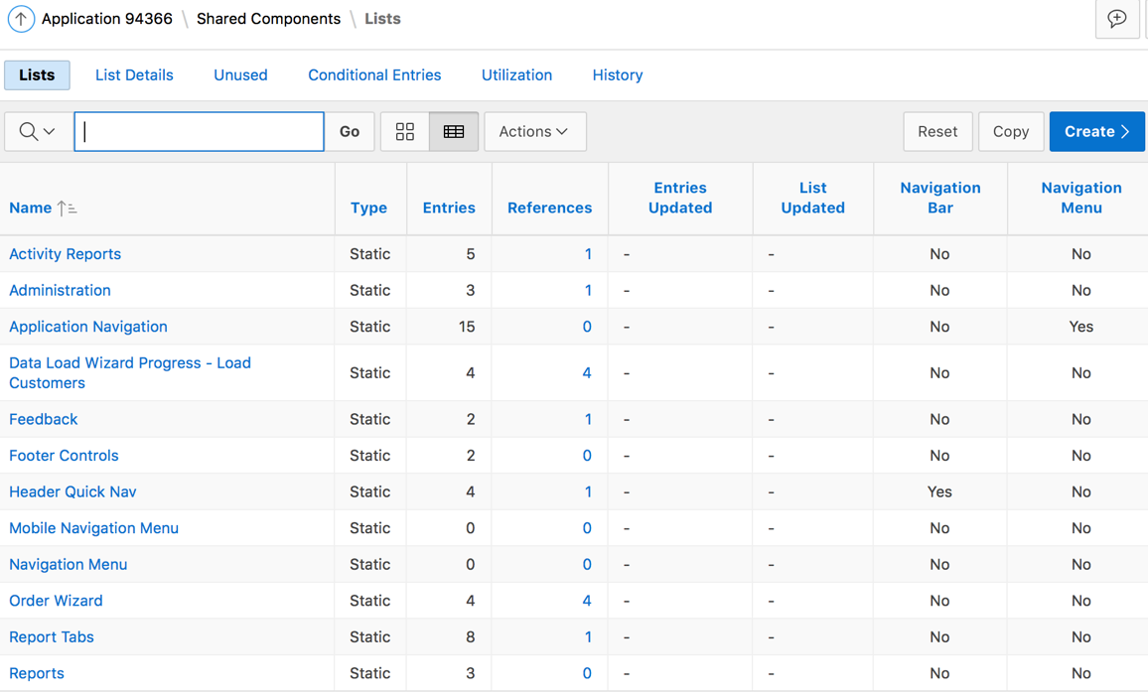
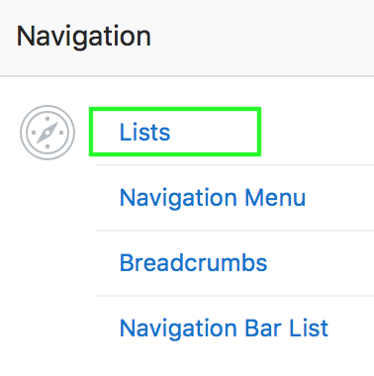
What are Lists?
A list is a template driven, shared collection of links
Oracle APEX supports two types of lists: Static, and Dynamic
Notes:
A list is a shared collection of links, each link is called a list entry. You add a list to a page by creating a region and specifying the region type as List. You control the appearance of a list through list templates. For example, you can create static list that functions as navigation using the template Vertical Unordered List with Bullets.
Oracle Application Express supports two types of lists:
Static Lists: When you create a static list you define a list entry label and a target (either a page or URL). You can add list entries when you create the list (creating from scratch), by copying existing entries, or by adding the list entries. You can control when list entries display by defining display conditions.
Dynamic Lists: Dynamic lists are based on a SQL query or a PL/SQL function executed at runtime. A dynamic list enables you to dynamically create styled list items that support mobile frameworks.
To access the Lists page, perform the following steps:
Navigate to your application home page and then click Shared Components
Under Navigation, click Lists. The Lists page is displayed. You see any existing lists under the Lists tab. The list definition displays a specific type of page item, such as progress bars, sidebar, bullet navigation list, or navigation menu. You can now either create a new list or copy a list. You can also invoke the Create List wizard in Page Designer. You learn how to create lists later in the next slide.
You can control how a list displays through templates.

Slide 7
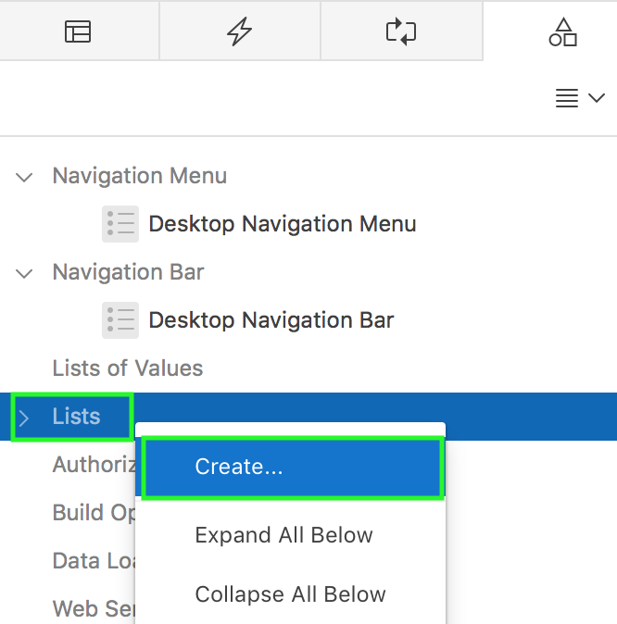
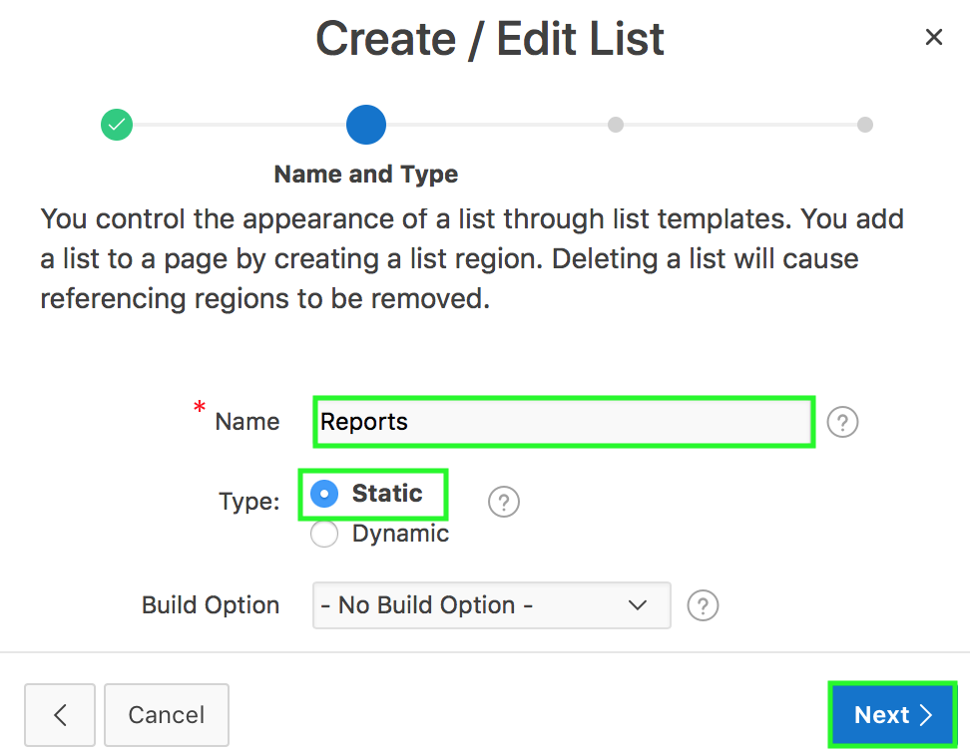
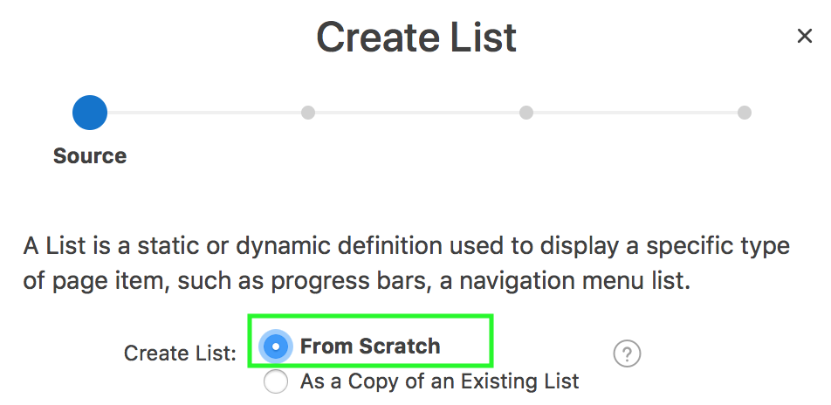
Creating a Static List: Steps
1
3
2
Notes:
You add a list to a page by creating a list region. Deleting a list will cause referencing regions to be removed. To create a static list from scratch, perform the following steps:
Access the Create/Edit Lists wizard. To do this, navigate to your application home page and then click Shared Components > Navigation > Lists and click Create. Alternatively, open any of your application pages (for example, home page) in page designer. Under Page Rendering > Page Shared Components, right click Lists and select Create.
For Source, select From Scratch and click Next.
Specify a name for your List, select Static for Type, and click Next

Slide 8
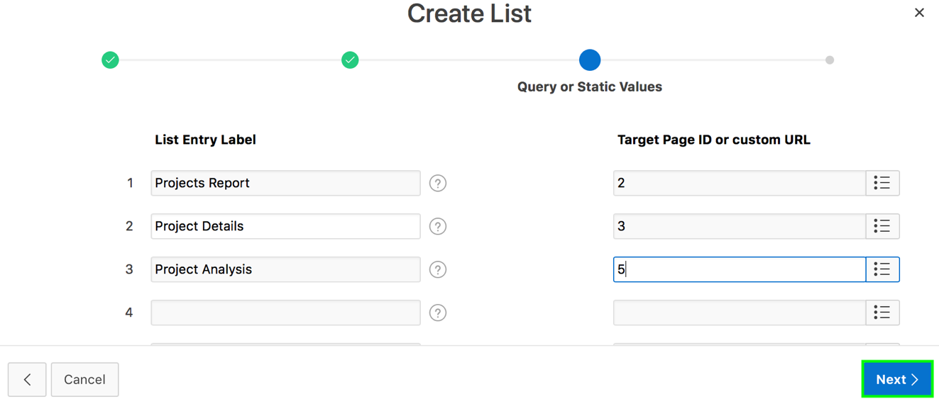
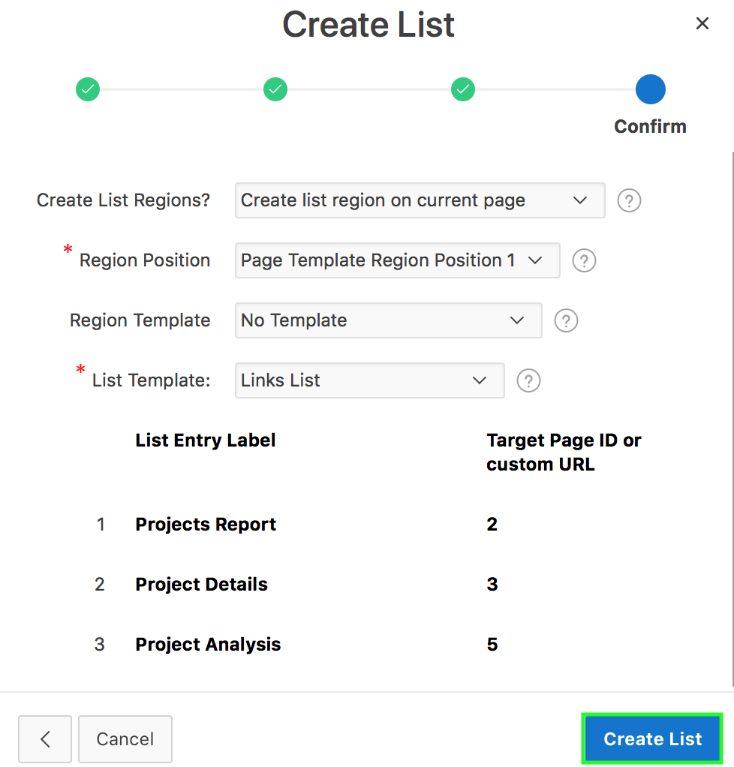
Creating a Static List: Steps
4
5
Notes:
For Query or Static Values:
List Entry Label - Enter a numeric or alphanumeric name for the list.
Target Page ID or custom URL - Select a target page or enter a custom URL.
Then, click Next.
A list region must be created on a page to display the list. For example, you create it on the Home Page. You can create a list region on the current page while creating the List itself. Alternatively, you can create it separately on the page where you want to display the list. On the Confirm page, specify your options and click Next. The static list is created. You can now edit the list if you want to add additional list entries.

Slide 9
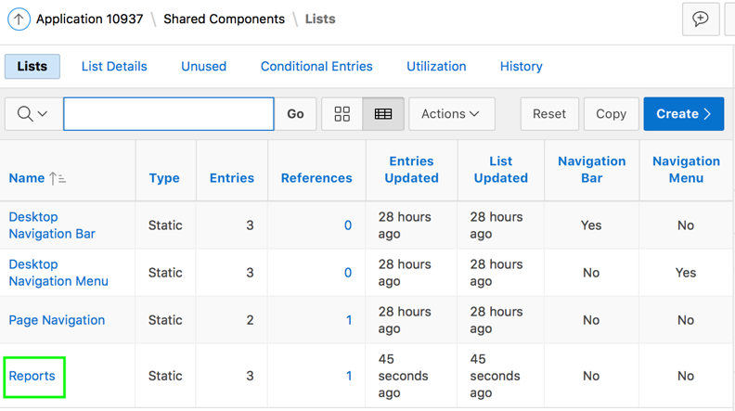
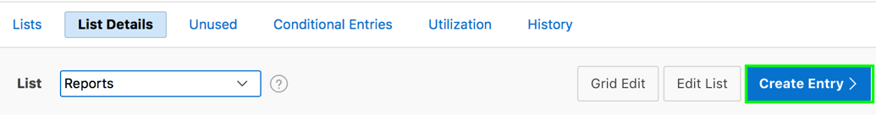
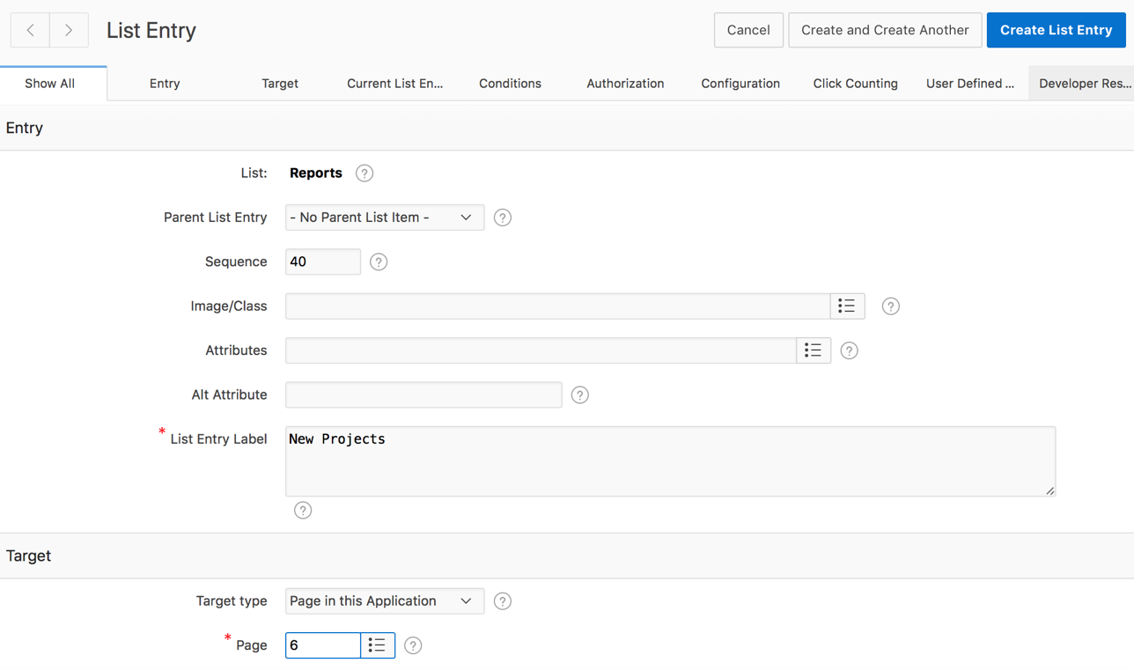
Adding Entries to a List
1
2
3
Notes:
Once you create a list, you must add entries to it. You can add list entries when creating a list from scratch, copying a list entry from within a list, or copying existing entries from one list to another. To add entries to a list, perform the following steps:
Navigate to the Lists page. Select a list. In the slide example, select Reports.
The List Details page appears. Click Create Entry.
Enter the text for the link in the List Entry Label field. Under Target, enter the page that you want to associate this list entry with. Click Create or Create and Create Another.
You can also create hierarchical lists that contain sublists. To create a hierarchical list, you must:
Select a list template that supports hierarchical lists. To determine which list templates support hierarchical lists, look for templates having the naming convention "with Sublist.”
Select a Parent List Item when you create each list entry.
You can copy a list from the current application or from another application. You can copy list entries from one list to another.

Slide 10
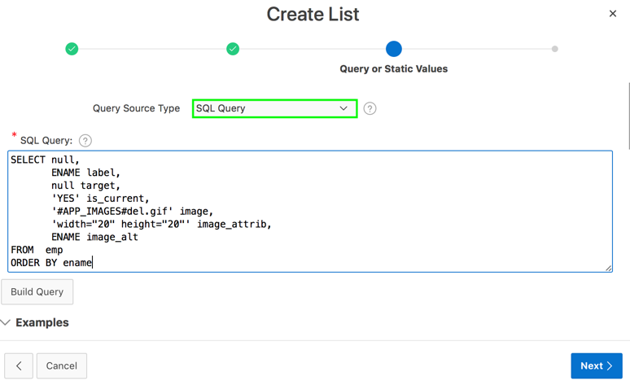
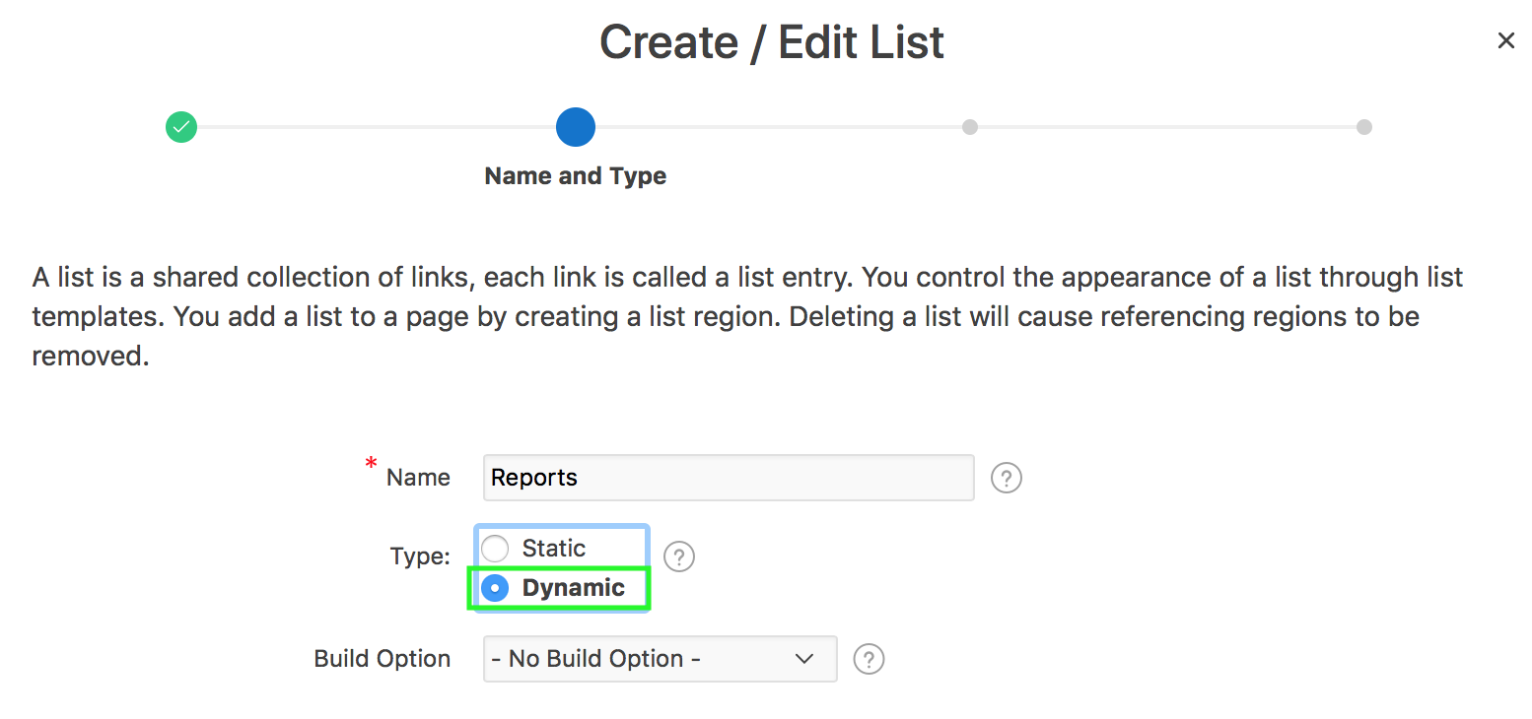
Creating a Dynamic List
Steps:
Create the list by running the Create List Wizard.
Specify whether to create the list from scratch or by copying an existing list.
If creating a list from scratch, you are prompted to select a list type. Select Dynamic.
Enter a SQL query or a PL/SQL function returning a SQL query.
Add the list to a page by creating a List region.
Notes:
A dynamic list enables you to dynamically create styled list items that support mobile frameworks. Dynamic lists are based on a SQL
query or a PL/SQL function returning a SQL query.
The slide provides steps to create a dynamic list. Once you create a list, you can edit it on the Lists page.

Slide 11
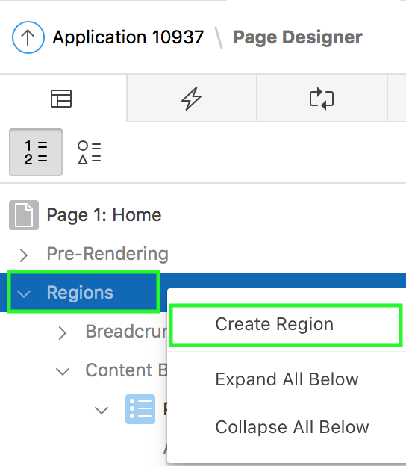
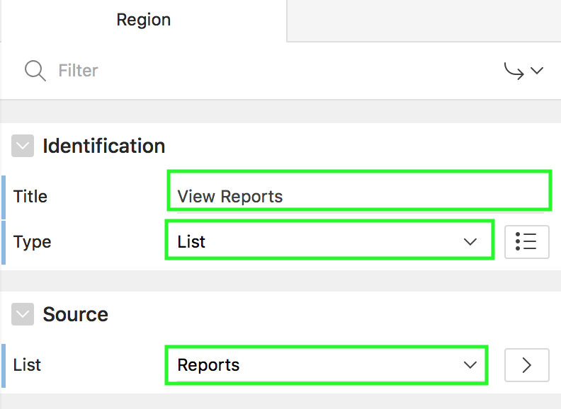
Adding a List to a Page
1
2
Notes:
Once you create a list and list entries, the next step is to add it to a page by creating a region and specifying the region type as List. You can
either create separate list regions on individual pages or you can create a list region in global page so that it appears on all the pages.
You can even specify the pages that should reflect the list region.
To add a list to a page, navigate to its page definition and perform the following steps:
In Page Designer, under Rendering, right-click Regions and click Create Region.
In the Property Editor of this region, select the Type as List and select the list from the List drop-down list. You see the list in the List region property editor only if the application already has a list. Optionally, specify any conditions for the display of the region. Click Save. The list region is created on the page.
To specify all those pages on which the list region should be displayed, expand Server-side Condition in the list region’s Property Editor. Select “Current Page is in comma delimited list” and then select all the pages in which you want this list region to be appeared.

Slide 12
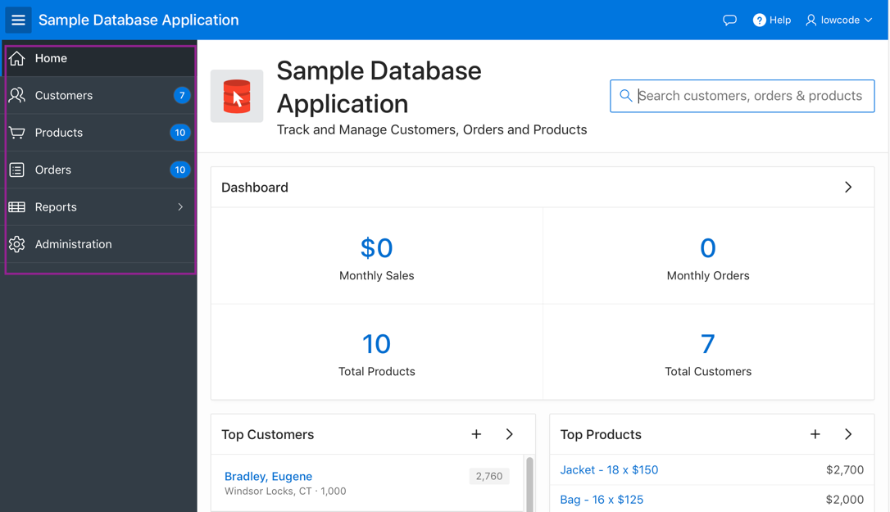
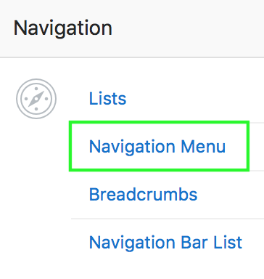
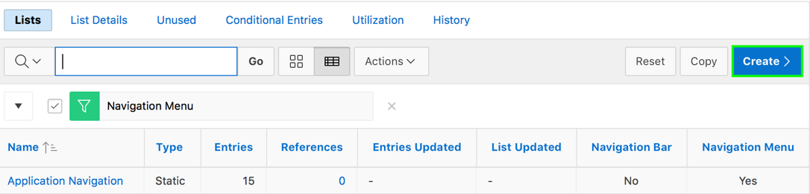
What is a Navigation Menu?
Navigation Menu
Notes:
In the slide, you see Sample Database Application that includes a navigation menu that displays in a sidebar.
Universal Theme provides navigation support through the creation of navigation menus. A navigation menu is a list with hierarchical list entries. When you create an application, the Create Application Wizard automatically creates a navigation menu for you and populates it with list entries linking to the application pages you have created.
Navigation menus support the creation of hierarchical sub-menus. You can render a navigation menus either at the top of the page as tabs or as a side bar (as shown in the previous example). Navigation menus displaying as a side bar are responsive. Based on the available space, the navigation bar displays a full menu or collapses to a narrow icon bar. Side navigation menus are controlled by the theme and user interface level. You can change how and where a navigation menu displays by editing the application User Interface Details.
The slide shows steps to access Navigation Menu in your application:
Navigate to the application home page.
Click Shared Components icon on the application’s home page
Locate Navigation and click Navigation Menu.
You can access Navigation menus in Shared Components in the Navigation region in either of the following two ways:
Select the application and then click Shared Components. Under the Navigation region, select Navigation Menu.
Select the application and then click Shared Components. Under the Navigation region, select Lists.
Note: You can switch from a theme using tabs to a theme using navigation menus if the existing application used one level of tabs was used. If an existing applications uses two levels of tabs, you must convert it to one level before changing the theme.

Slide 13
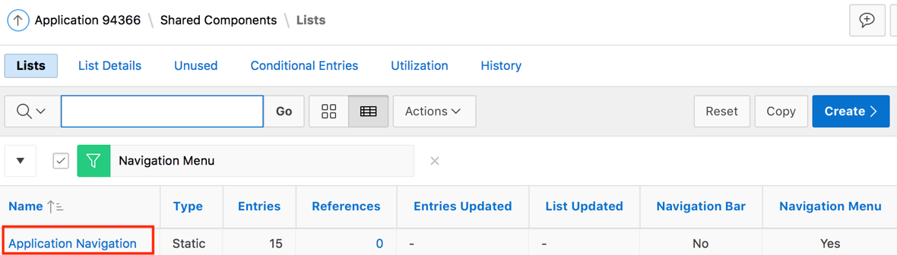
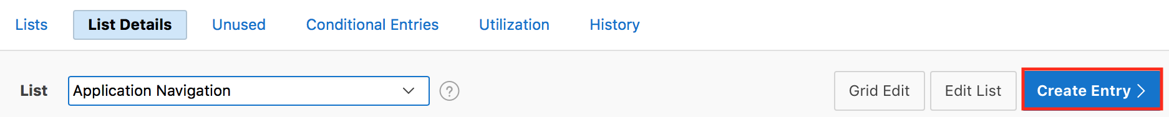
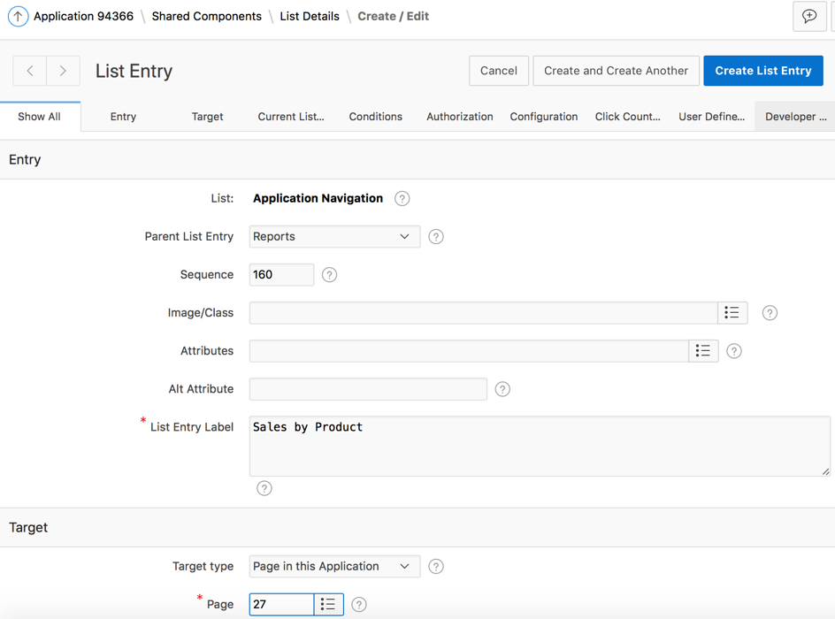
Creating a Navigation Menu Entry
2
1
3
Notes:
The slide shows steps to create a navigation menu entry.
Click Shared Components icon on the application’s home page. Locate Navigation and click Navigation Menu. Now, select a navigation menu. For example, in the slide, select Application Navigation.
Click Create Entry.
Enter details such as Parent List Entry, List Entry Label, Target Type, and Target Page. Then, click Create List Entry

Slide 14
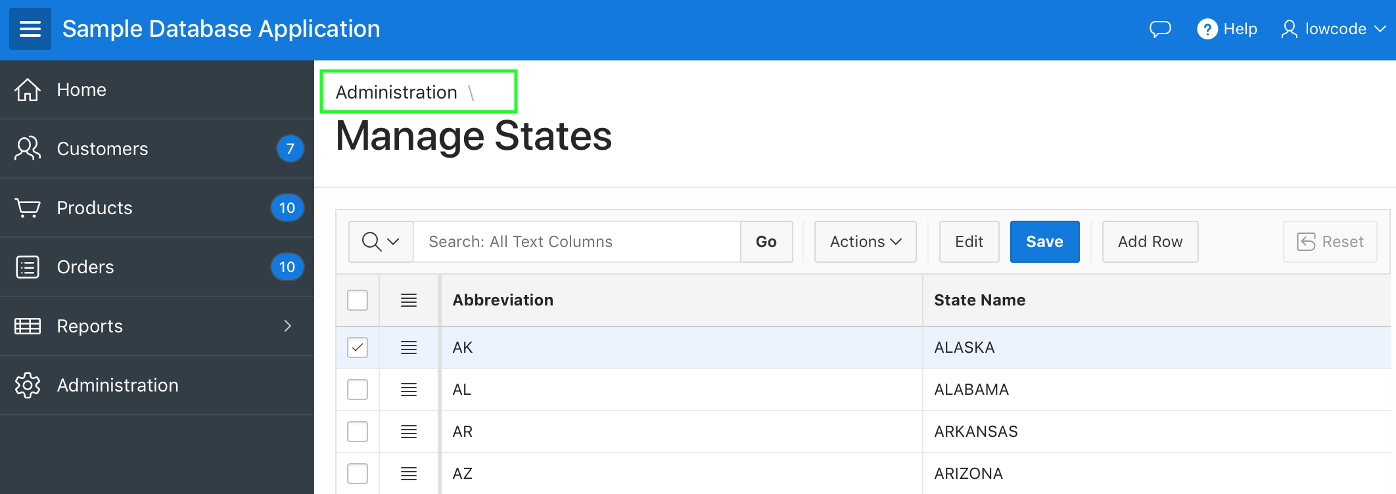
What is a Breadcrumb?
A breadcrumb is a hierarchical list of links that display using templates
Breadcrumb
Notes:
A breadcrumb is a hierarchical list of links that indicates where the user is within the application from a hierarchical perspective. Users can click a specific breadcrumb link to instantly view the page. You use breadcrumbs as a second level of navigation at the top of each page, complementing other user interface elements such as tabs and lists.
Breadcrumbs can be displayed on a page by adding a breadcrumb region using the create region wizard. You can define a Breadcrumb region in global page so that it appears on all pages or on each page individually. You can also define conditions to exclude the breadcrumb region from specific pages where they are not to be displayed.

Slide 15
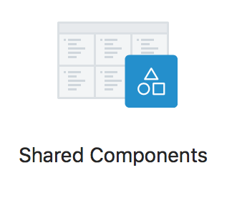
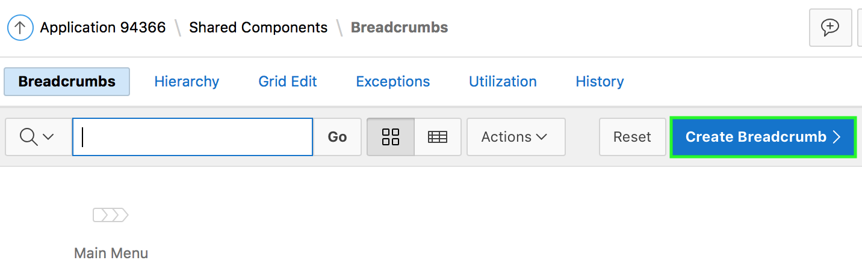
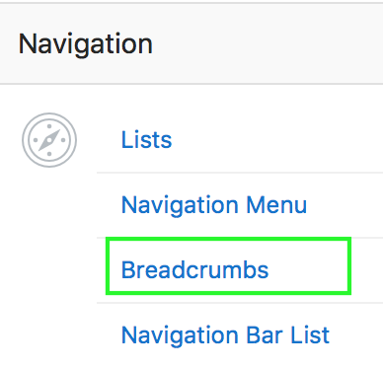
Creating a Breadcrumb
Steps:
Create the breadcrumb by running the Create/Edit Breadcrumb Wizard.
Add entries to the breadcrumb.
Add the breadcrumb to a page by creating a region.
Notes:
You create the breadcrumb by running the Create/Edit Breadcrumb Wizard. You can access this wizard in two ways:
Go the Shared Component page and select Create Breadcrumb.
In Page Designer, select the Create menu and then Breadcrumb Region.
By default, each application contains one breadcrumb. The breadcrumb contains multiple breadcrumb entries. To view the breadcrumb for an application, perform the following steps:
Navigate to your application home page. Then, click Shared Components.
On the Shared Components page, under Navigation, click the Breadcrumbs link.
On the Breadcrumbs page, the existing breadcrumb is listed. Click the icon to view the breadcrumb entries for the breadcrumb. To create a new breadcrumb, click Create Breadcrumb. The Breadcrumb Entry page appears where you can define the page details for which a Breadcrumb entry is required. You can even create a breadcrumb entry for a page while creating a page using the Create Page Wizard.

Slide 16
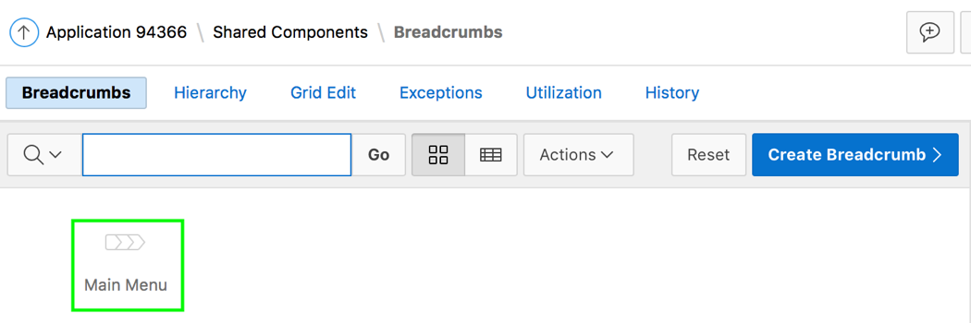
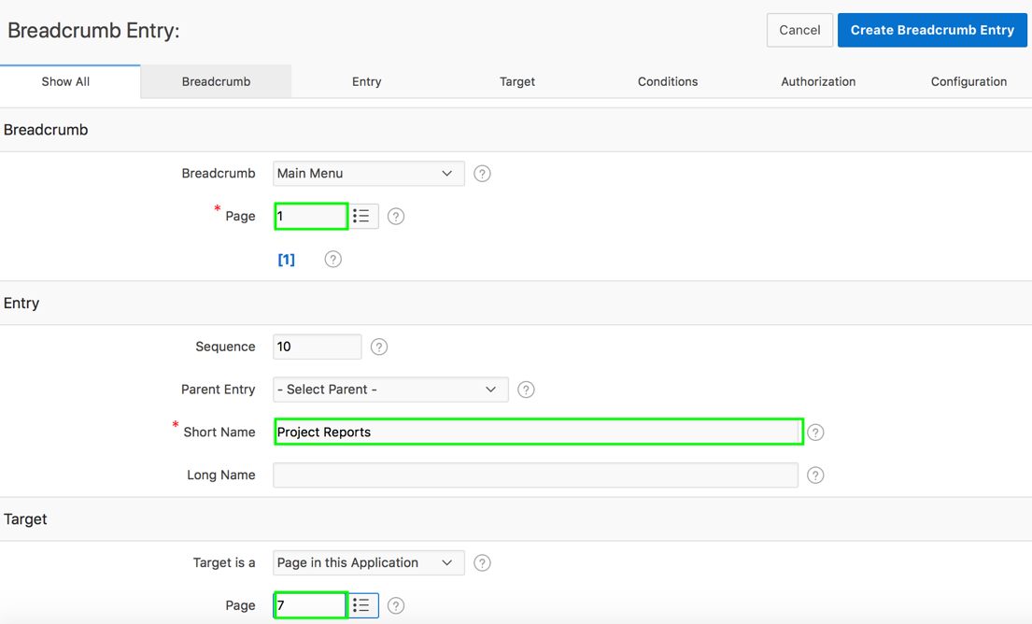
Adding Breadcrumb Entries
2
1
3
Notes:
By default, each application contains one breadcrumb. The breadcrumb contains multiple breadcrumb entries. To add entries to a breadcrumb, perform the following steps:
Select a breadcrumb to which to add entries.
Click Create Breadcrumb Entry.
Under Breadcrumb, select the page where this breadcrumb entry displays. Under Entry, enter the short name for the breadcrumb entry. In the Target section, specify the page that should appear when the entry is clicked. Click Create Breadcrumb Entry. Repeat these procedures for each breadcrumb entry you create.
Note: There is an option to synchronize the corresponding Page Name and Title with the Breadcrumb Short Name. To do this, check the Page Name and Title checkbox and Apply Changes.

Slide 17
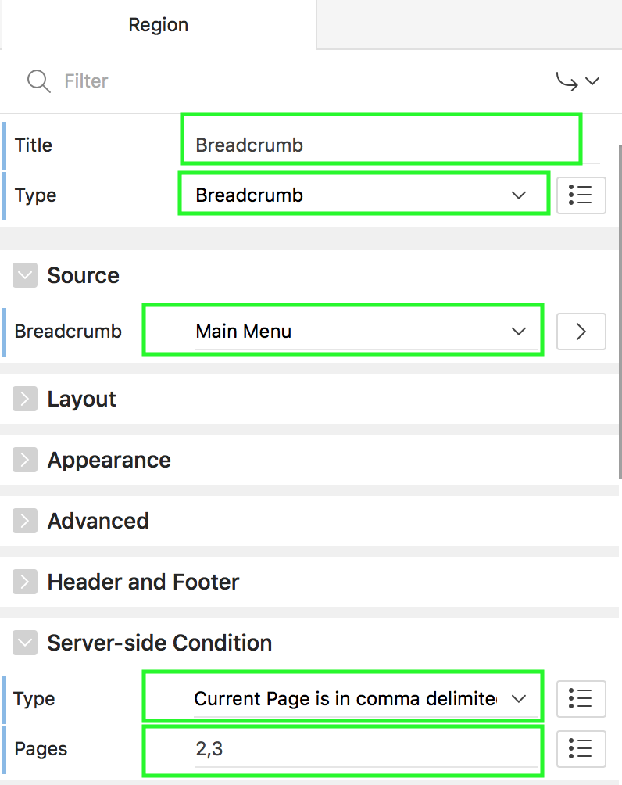
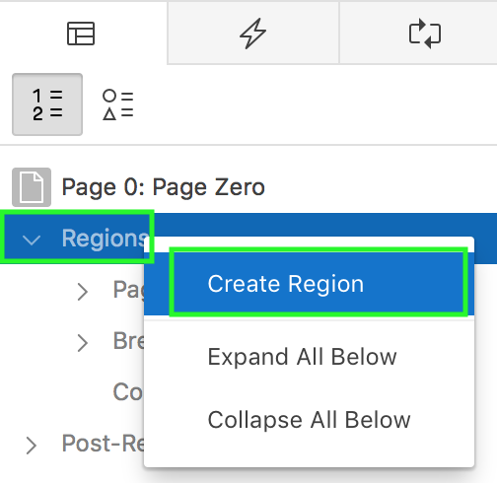
Adding a Breadcrumb Region in a Page
Notes:
The slide shows creating a breadcrumb region on global page. By creating a breadcrumb region on global page, the breadcrumb appears on all pages in the application. You can either create separate breadcrumb regions on individual pages or you can create the breadcrumb region in global page. The breadcrumb appears on the page when the application is run only if a breadcrumb was created for that page from Shared Components. Note that you can even specify the pages in your application that should display the breadcrumb.
To add a breadcrumb region in a page, perform the following steps:
Navigate to the page definition of your page, for example, global page.
Right-click Regions and select Create Region.
In the Property Editor, specify a title, and select Breadcrumb for Type. Update other properties such as Position on the page and so on. The breadcrumb region is now created.
To specify the pages on which the breadcrumb region should be displayed, select the breadcrumb region node and expand Server-side Condition in the Property Editor. Select “Current Page is in comma delimited list” and select the pages in which you want this breadcrumb region to be appeared. Now, ff you run the application, you should see the breadcrumb region on the pages that you specified.
In the Page Designer, you can also select the Breadcrumb region from the Gallery and drag it to the appropriate location in the Layout tab.
Alternatively, in the Gallery, click the Regions tab. Then, right-click Breadcrumb, select Add To, and select the appropriate location.
Note: A global page functions as a master page.
The Application Express engine renders all components you add to a Global page on every page within your application. You can further control whether the Application Express engine renders a component or runs a computation, validation, or process by defining conditions.

Slide 18
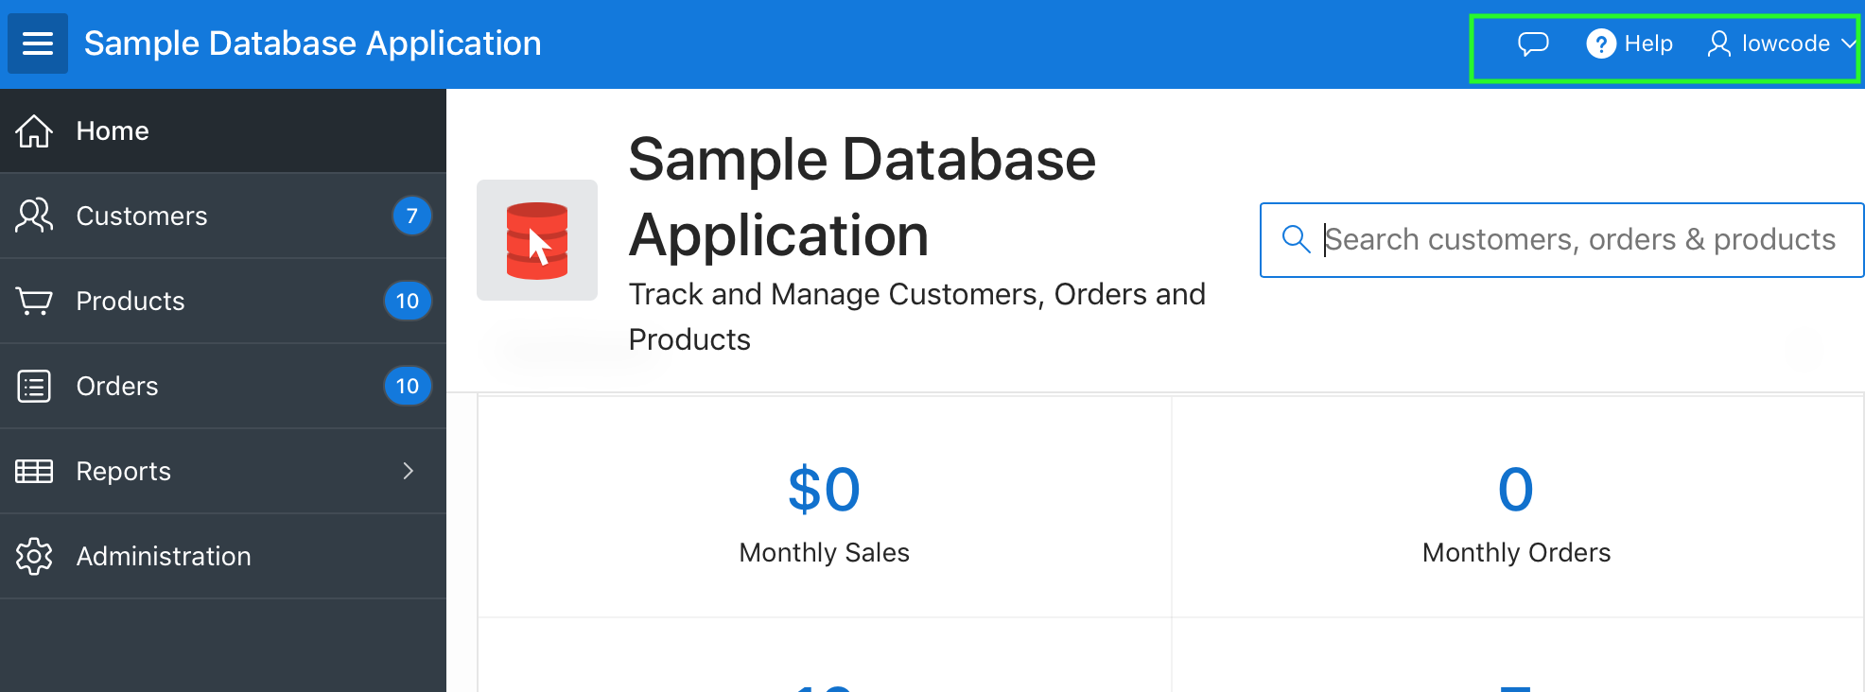
What is a Navigation Bar Entry?
Navigation bar entries offer an easy way to move users between pages in an application.
A navigation bar entry can be an image, text, or an image with text beneath it.
Navigation bar entries
Notes:
Navigation bar entries offer an easy way to move users between pages in an application. A navigation entry enables you to display a link from an image or text. For example, you might want to add navigation bar entries for accessing the Help and Feedback pages in your application. A navigation bar entry can be an image, text, or an image with text beneath it. You must supply the images and text to use in the navigation bar entries.
An application can have only one navigation bar. The associated page template determines the location of a navigation bar. Navigation bars are different from other shared components in that you do not need to reference them on a page-by-page basis. If your page template includes the #NAVIGATION_BAR# substitution string, the Application Express engine automatically includes any defined navigation bars when it renders the page.

Slide 19
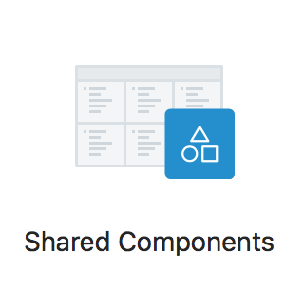
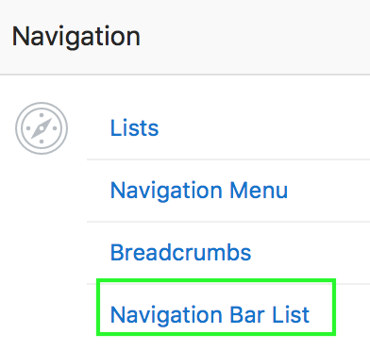
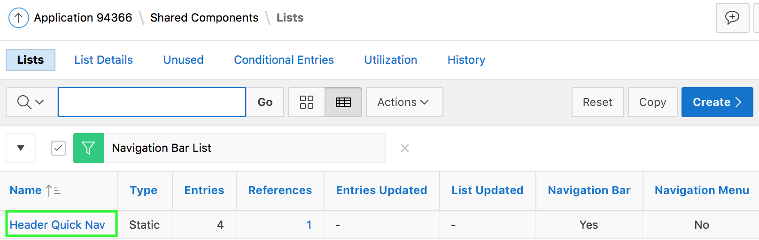
Accessing the Navigation Bar List
Notes:
To access the navigation bar and view the navigation bar entries in your application, perform the following steps:
Navigate to your application home page and click Shared Components.
Under Navigation, select Navigation Bar List. Select the navigation bar to view the navigation bar entries.

Slide 20
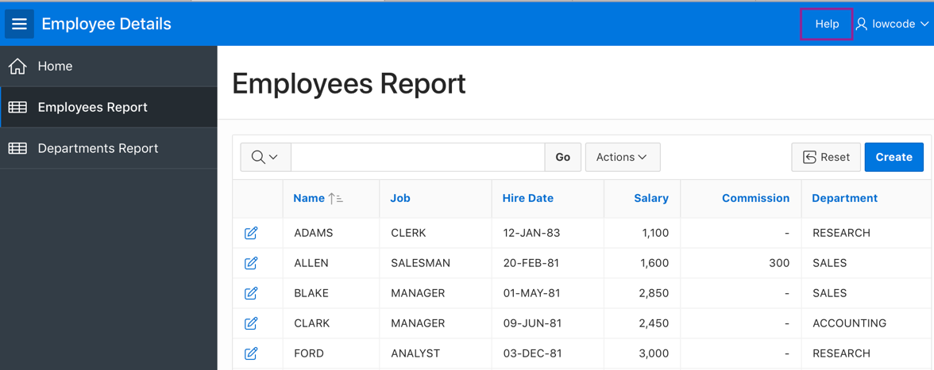
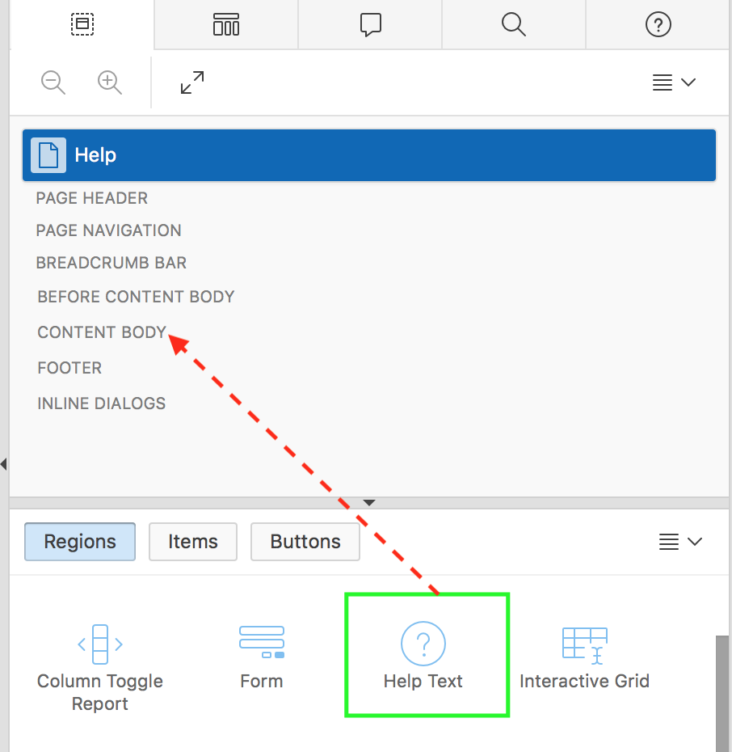
Creating a Navigation Bar Entry: Example
Drag and drop
Create a blank page and add a Help Text region type
Create a navigation bar entry for Help
Adding a Help Text region type
Notes:
The slide lists two steps to display a Help navigation bar entry on your application. First, you create a blank page. Then, navigate to Gallery, drag the Help Text region type and drop it in a desired location. In the property editor, specify the page title and save the changes.
Once the page is created, you then create a navigation bar entry for this page in the next slide.
In the slide example, you cannot run the Help page directly. For the help text to be displayed on any page, you should perform the following steps:
Navigate to the corresponding page in page designer.
In the property editor, navigate to Help. Enter the value for Help Text. Click Save.

Slide 21
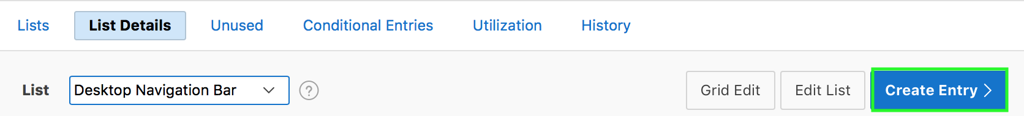
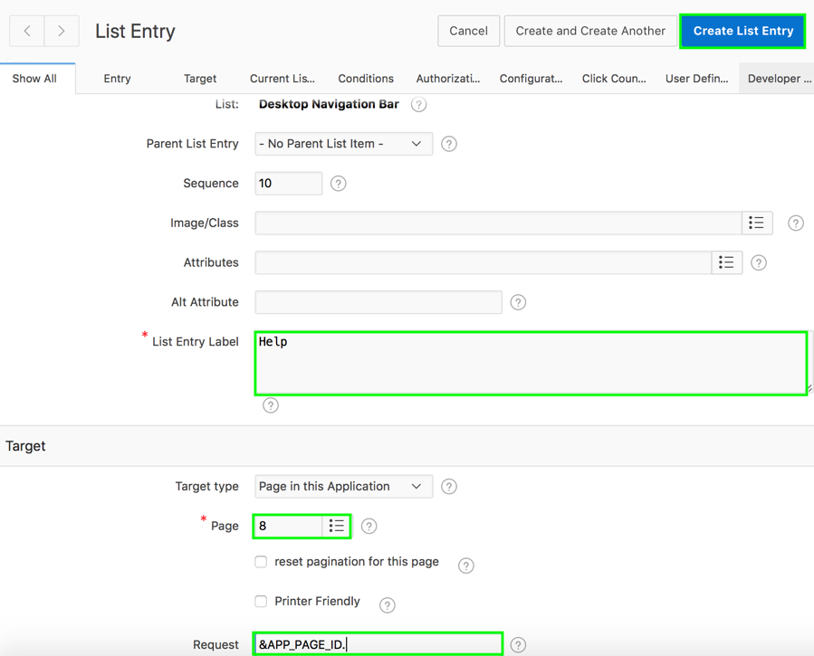
Creating a Navigation Bar Entry: Example
Notes:
After creating a Help page and adding the Help Text region type, perform the following steps to create a navigation bar entry:
Navigate to application home page and click Shared Components.
Under Navigation, select Navigation Bar List.
Now, click Desktop Navigation Bar and click Create Entry.
Specify values for List Entry Label, Target type, and Page. In the slide, specify Page in the Application for Target Type, and select the Help page number for Page.
For Request, enter &APP_PAGE_ID. And then click Create List Entry. Now, you can run the application and click Help in the navigation bar.

Slide 22
Summary
In this lesson, you learned how to create, edit and use the following shared components that aid navigation in an application:
Lists
Navigation Menus
Breadcrumbs
Navigation bar entries

Slide 23


Slide 24
Hands-on Lab

